Slide 1
Demand Forecasting
“Predicting Future Demand with Time Series Analysis”
Project – P275
ExcelR Solutions

Slide 2
OUR MENTOR:
Madishetti Rajshekar
Project Coordinator:
Bapuram Pallavi
SUBMITTED BY (TEAM 5)
Deepti Lalwani
U Yeshwanth Kumar
Rangana Naveen Sai

Slide 3
Project Agenda
Topics included in this presentation:
Introduction
Data collection and exploration
Data pre processing
Exploratory data analysis (EDA)
Stationarity check
Model selection
Model evaluation
Best model and its parameters
Model deployment
Conclusion

Slide 4
Introduction
Demand forecasting is the practice of using historical data and analytical techniques to make predictions about future customer demand for a product or service.
In our project, we have access to a rich dataset spanning five years, encompassing sales data and promotional activities.
Our dataset include:
Sales figures for various products
Information on marketing campaigns, discounts, or promotions.
Seasonal fluctuations and trends in customer purchasing behaviour.
Our project aims to leverage time series analysis techniques on this dataset to predict future demand accurately, empowering businesses to proactively adapt their strategies, reduce operational costs, and deliver a superior customer experience.

Slide 5
Data Collection and Exploration
Data sources and types: we had given data from a dataset called "train.Csv," which contains valuable information for our demand forecasting project.
The dataset includes key columns such as:
Store_nbr: identifying the store where the products are sold.
Family: identifying the type of product sold.
Sales: representing the total sales for a product family at a specific store on a given date. These sales figures may include fractional values, reflecting products sold in fractional units.
On promotion: indicating the total number of items in a product family that were being promoted at a store on a given date.

Slide 6
Data Pre processing
Handling missing values:
There were no missing values in any of the columns, ensuring data completeness and reliability.
Dealing with outliers:
To mitigate the impact of outliers, we applied a logarithmic transformation to the "sales" column. This transformation effectively addressed outliers, ensuring a more robust analysis without distortion.
Data transformations:
Date as an index:
We transformed the "date" column into an index, facilitating time-series analysis.
Weekly data resampling:
To capture meaningful patterns in our time series, we resampled the "sales" data on a weekly basis.
This resampling allowed us to analyse and forecast weekly sales trends.
Temporal range : our dataset covers a time span from the earliest date in january 2013 to the latest date in august 2017.

Slide 7
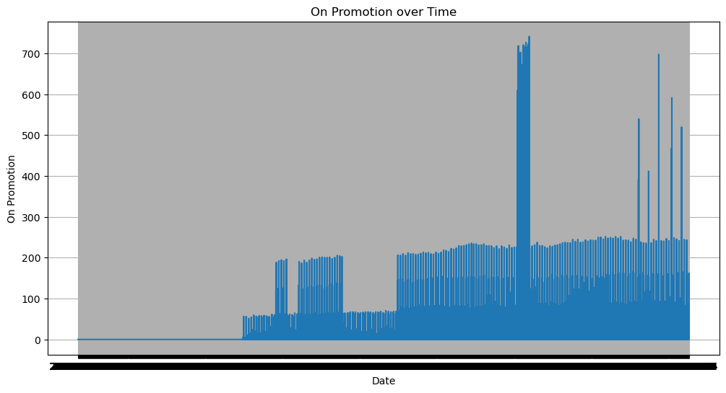
Exploratory Data Analysis (EDA)
Visualizing on promotion over time:
To understand the impact of promotions on sales, we visualized the trend of "on promotion" over time.
This allowed us to identify periods of active promotions.

Slide 8
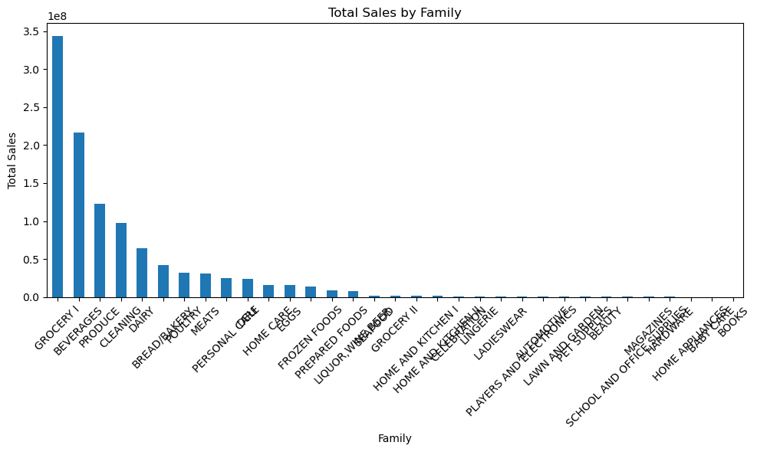
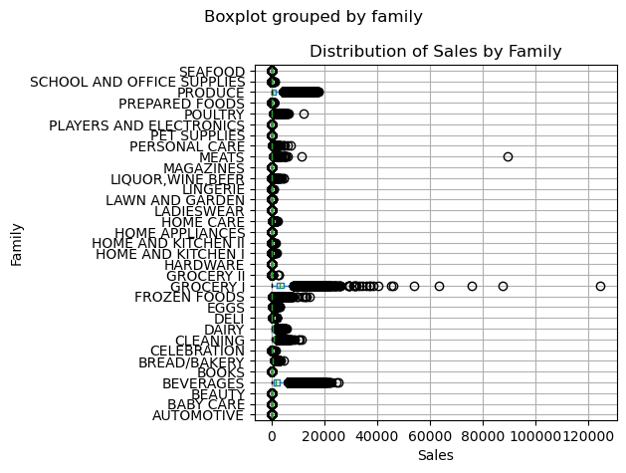
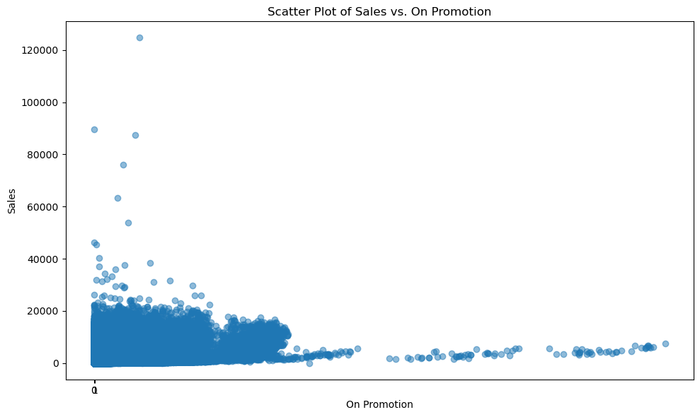
Family-wise analysis:
We conducted a family-wise analysis to gain insights into product categories' sales.
Key visualizations:
Bar plot: total sales for each family - grocery I emerged as the highest-selling family.
Box plot: distribution of sales for each family, revealing variations and outliers.
Scatter plot: exploration of the relationship between sales and on promotion.

Slide 9
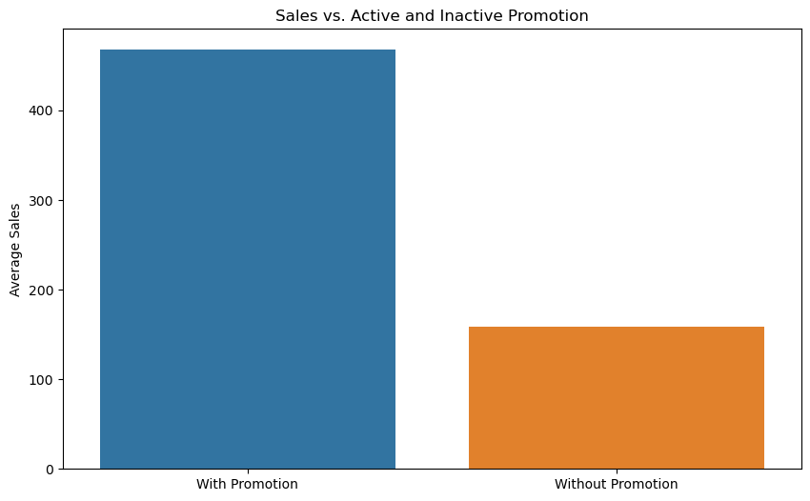
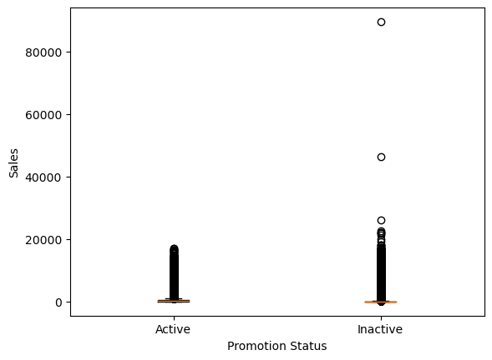
Promotion analysis:
Examining the effect of promotions on sales, we observed:
More instances of higher sales during active promotions compared to inactive promotions.
Box plots highlighting that active promotions had a higher median sales value and a wider sales range.
Identification of potential outliers in both active and inactive promotions, signifying unusually high sales.

Slide 10
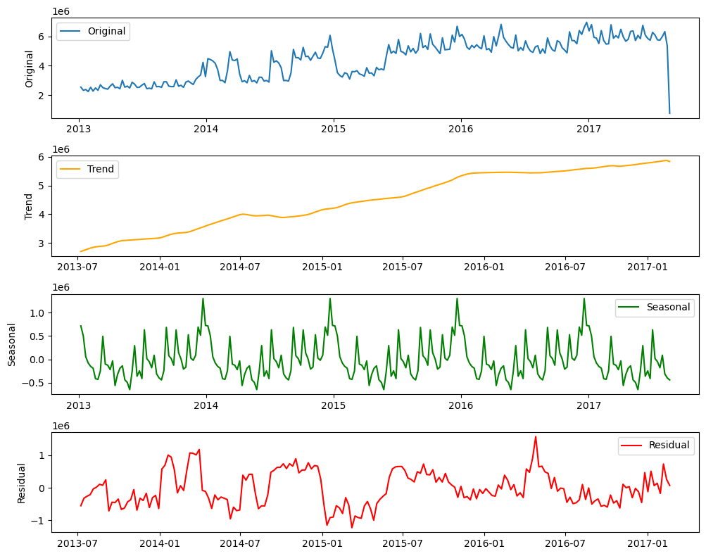
Decomposition of time series data:
Decomposing time series data to identify trends,
Seasonality , and residuals.
Key observations:
Clear annual seasonality pattern confirming
a yearly seasonal period.
Increasing trend in the dataset representing
Long-term movement.
Residual component capturing random noise
or regular fluctuations.

Slide 11
Stationarity Check
Stationarity is essential in time series data as it ensures that statistical properties remain constant over time, making the data predictable.
Methods used for stationarity analysis:
Employed the augmented dickey-fuller (adf) test, a statistical hypothesis test, to assess stationarity.
Considering the large dataset, worked with a sample or aggregated data for efficiency.

Slide 12
Making data stationary:
Employed differencing, which involves subtracting the previous time point's value from the current time point's value.
Emphasized the importance of considering original data characteristics.
Results of stationarity analysis:
ADF test outcomes determined stationarity.
Utilized visualizations like rolling statistics to show changes in mean and standard deviation.
Interpretation: small deviations in rolling statistics compared to data range suggested achieved stationarity via first differencing was sufficient for modelling.

Slide 13
Model Selection
Time series forecasting models considered:
Arima
Sarima
Sma
Exponential smoothing
Triple exponential smoothing
Random forest
Decision trees
Linear regression
Neural network
Criteria for model selection:
Mean absolute percentage error (MAPE): measures forecast accuracy; lower values are preferred.
Overall accuracy: assesses how well the model predicts future demand.
Akaike information criterion (aic) and bayesian information criterion (bic): indicate model goodness-of-fit; lower values indicate better fit.

Slide 14
Rationale behind chosen model:
After comprehensive evaluation, the triple exponential smoothing model emerged as the best choice.
Lowest mape (0.09) signifies the highest forecast accuracy.
Adequate aic and bic values demonstrate a good model fit.
Triple exponential smoothing effectively captured the complex time series patterns and seasonality in our sales data, making it the preferred model for demand forecasting.
For utmost accuracy, triple exponential smoothing is the top choice.
If regularity in demand intervals is crucial, linear regression excels.
To minimize variation in quantities, triple exponential smoothing is favored.
The best model balances accuracy, regularity, and variation.
Therefore, we select triple exponential smoothing (tes) as the best model for optimal forecast accuracy and demand stability.

Slide 15
Model Evaluation
Evaluation metrics for model performance:
Mean absolute percentage error (MAPE) is used to assess accuracy.
Results of model evaluation:
Arima: mape = 4.56
Sarima: mape = 6.42
Sma: mape = 3.64
Exponential smoothing: MAPE = 2.15
Triple exponential smoothing: MAPE = 0.09
Random forest: MAPE = 1.94
Decision trees: MAPE = 2.02
Linear regression: MAPE = 7.53
Neural network: MAPE = 7.29
Triple exponential smoothing achieved the lowest MAPE, indicating the highest accuracy among the models evaluated.

Slide 16
Best Model and Its Parameters
Introduction to the selected model:
The best-performing model for demand forecasting is 'triple exponential smoothing.'
Model parameters and configuration:
'Triple exponential smoothing' has three smoothing parameters:
Alpha (α): 0.5 (level smoothing)
Beta (β): 0.2 (trend smoothing)
Gamma (γ): 0.2 (seasonality smoothing)
Grid search for optimization:
The model's parameters were optimized using grid search to maximize forecast accuracy.
Mean absolute error (mae) after optimization: 0.4463
Accuracy of 'triple exponential smoothing': 99.91%
Low MAPE value, indicating that the model's forecasts closely align with observed sales data, ensuring accurate demand forecasting.

Slide 17
Model Deployment
Deployment in a real-world setting:
In a real-world business setting, deploying the 'triple exponential smoothing' model for demand forecasting involves a systematic process. This model is designed to provide accurate and stable predictions of future demand based on historical sales data.
Challenges and considerations:
While deploying the model offers numerous benefits, there are challenges and considerations to keep in mind:
Integration: integrating the model with existing systems and databases can be complex. It requires compatibility with different data formats and platforms.
Data updates: as new sales data becomes available, the model needs to be updated and retrained regularly to maintain accuracy. This process should be automated to minimize downtime.
Scalability: the model should be scalable to handle variations in demand patterns across different product categories or store locations. Customization may be required.
Monitoring: once deployed, the model must be monitored for performance. Deviations from forecasts should trigger alerts, allowing for corrective actions.
Maintenance: ongoing maintenance and optimization are essential. Model parameters may need adjustment as market conditions change, and new data becomes available.

Slide 18
Conclusion
Key findings and results:
In this demand forecasting project, we embarked on a journey to predict future demand using time series analysis. Here are the key findings and results:
Model selection: we considered various time series forecasting models, including ARIMA, SARIMA, exponential smoothing, random forest, and more. Through rigorous evaluation, we identified the 'triple exponential smoothing' model as the best performer, balancing accuracy, regularity, and demand stability.
Model evaluation: the 'triple exponential smoothing' model demonstrated remarkable accuracy, with a mape of just 0.09%. This indicates that the model's forecasts closely align with observed sales data, showcasing its predictive power.
Model deployment: we explored how to deploy the chosen model in a real-world setting. Automation, data integration, and regular updates were highlighted as key steps in ensuring the model's continued effectiveness.

Slide 19
Significance of project outcomes:
The outcomes of this project hold immense significance for businesses in various industries. Accurate demand forecasting is crucial for:
Inventory management: businesses can optimize inventory levels, reducing carrying costs while ensuring product availability.
Resource allocation: staffing, production, and distribution resources can be allocated efficiently based on predicted demand patterns.
Marketing strategies: promotional efforts can be aligned with expected demand fluctuations, maximizing their impact.
Customer satisfaction: meeting customer demand effectively leads to higher customer satisfaction and loyalty.
Cost reduction: minimizing excess inventory and stockouts results in cost reductions and improved profitability.

Slide 20
Challenges and considerations
While deploying the model offers numerous benefits, there are challenges and considerations to keep in mind
Integration: integrating the model with existing systems and databases can be complex. It requires compatibility with different data formats and platforms.
Data updates: as new sales data becomes available; the model needs to be updated and retrained regularly to maintain accuracy. This process should be automated to minimize downtime.
Scalability: the model should be scalable to handle variations in demand patterns across different product categories or store locations. Customization may be required.
Monitoring: once deployed, the model must be monitored for performance. Deviations from forecasts should trigger alerts, allowing for corrective actions.
Maintenance: ongoing maintenance and optimization are essential. Model parameters may need adjustment as market conditions change, and new data becomes available.

Slide 21
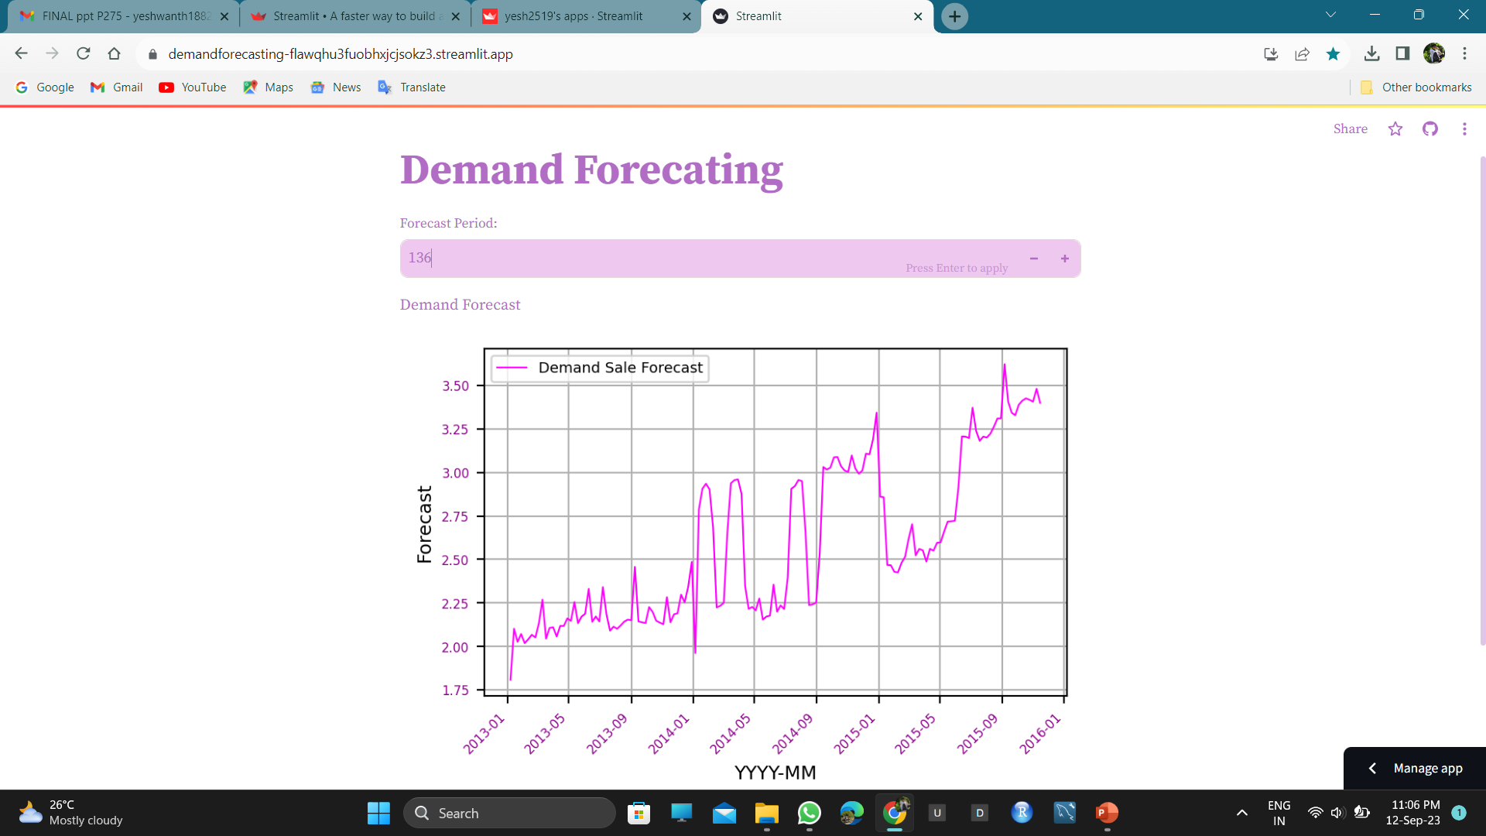
DEPLOYMENT WEB PAGE

Slide 22
THANK YOU

